Slide 1
MiniLedger: Compact-Sized Anonymous and Auditable Distributed Payments
ESORICS 2021
Panagiotis Chatzigiannis and Foteini Baldimtsi
George Mason University, Fairfax, USA
Notes:
Miniledger：小型的匿名可审计分布式支付系统

Slide 2
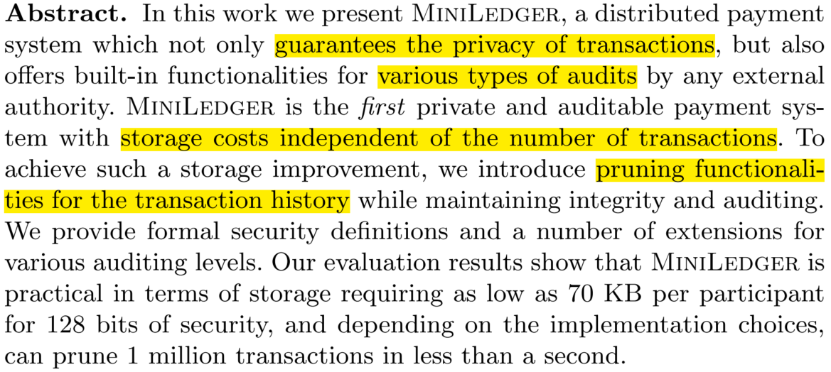
Abstract
Notes:
设计了一种分布式支付系统，不仅能实现交易隐私保护和多种审计方式，还支持修剪历史数据以减少链上数据

Slide 3
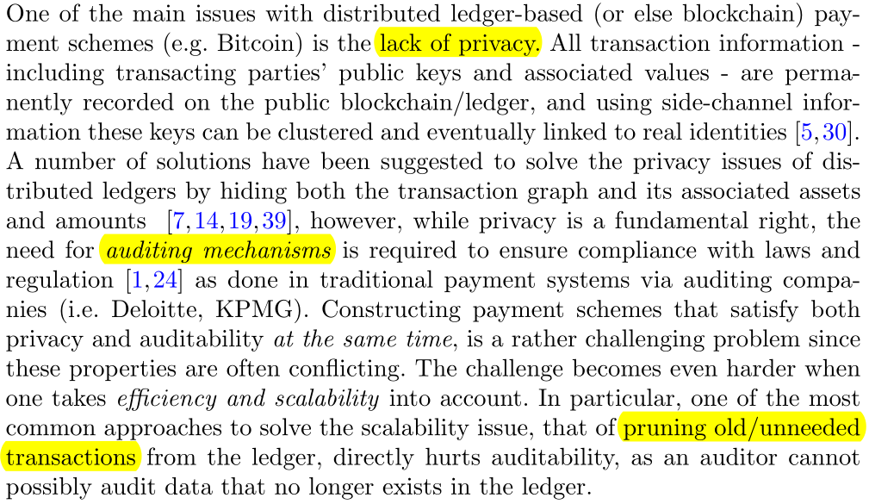
Introduction
金融机构跨组织交易
交易数据隐私
第三方交易审计机制
随着时间推移，旧数据在链上留着意义不大且占空间，通过Pruning(修剪)历史数据可降低节点本地存储代价，但影响修剪数据的审计
Notes:
分布式账本帮助金融机构能够有效地协调跨组织交易。例如，银行可能使用分布式账本作为数字资产的结算日志。

Slide 4
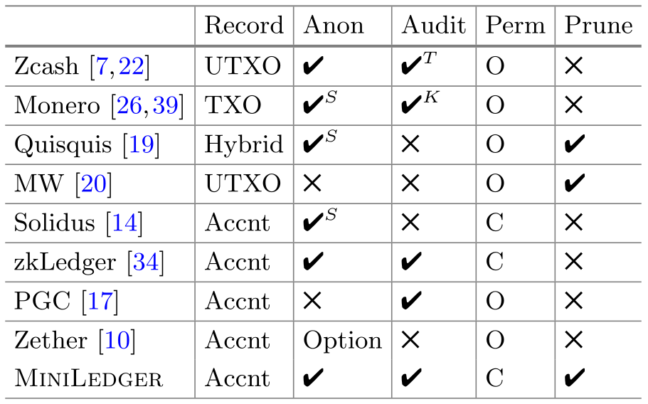



Related work
Set anonymity
Auditing through a TP
Auditing through “view keys”
Permissionless
Permissioned
[34] Narula, N., Vasquez, W., Virza, M.: zkledger: privacy-preserving auditing for distributed ledgers. USENIX (2018)

Slide 5
Contributions
We present MiniLedger: the first space efficient (transaction pruning), distributed private payment system that allows an authorized set of participants to transact with each other, while also allowing for a wide set of auditing by consent operations by any third party auditor.
We show that transaction computation cost, for a system with 100 Banks, takes about 4 sec, while transaction auditing is less than 5 ms, independent of the number of Banks.
银行间的支付系统：隐私+审计+修剪

Slide 6
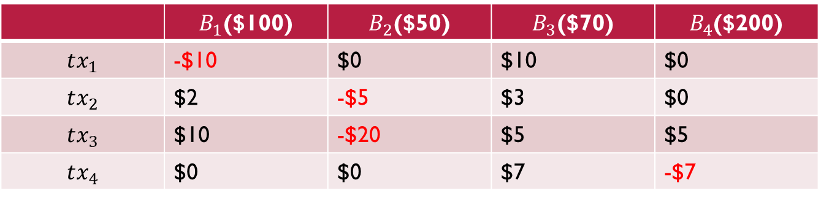
Ledger constriction & Audit
 | $B_{1}$($100) | $B_{2}$($50) | $B_{3}$($70) | $B_{4}$($200)
$$tx_{1}$$ | -$10 | $0 | $10 | $0
$$tx_{2}$$ | $2 | -$5 | $3 | $0
$$tx_{3}$$ | $10 | -$20 | $5 | $5
$$tx_{4}$$ | $0 | $0 | $7 | -$7
透明
数据
单笔交易审计：收支平衡，透支/负额/额度检查，金额审计
多笔交易审计：总金额审计，余额审计
修剪审计：交易被修剪后仍支持上述审计功能
Notes:
柱状账本结构
Proof of balance
Proof of assets

Slide 7
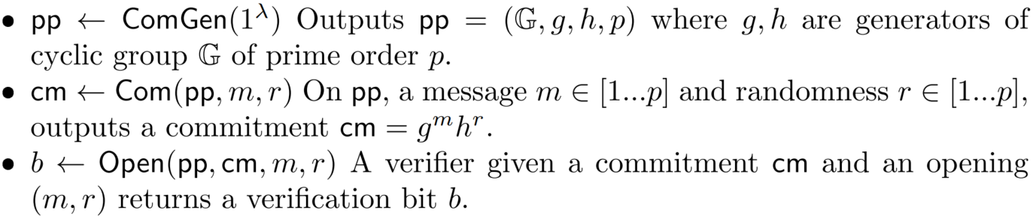
Preliminaries
Commitment schemes

Slide 8
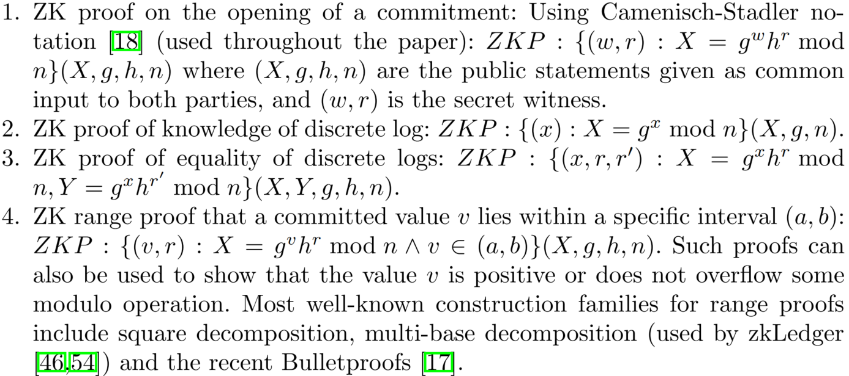
Preliminaries
Zero-knowledge proofs

Slide 9
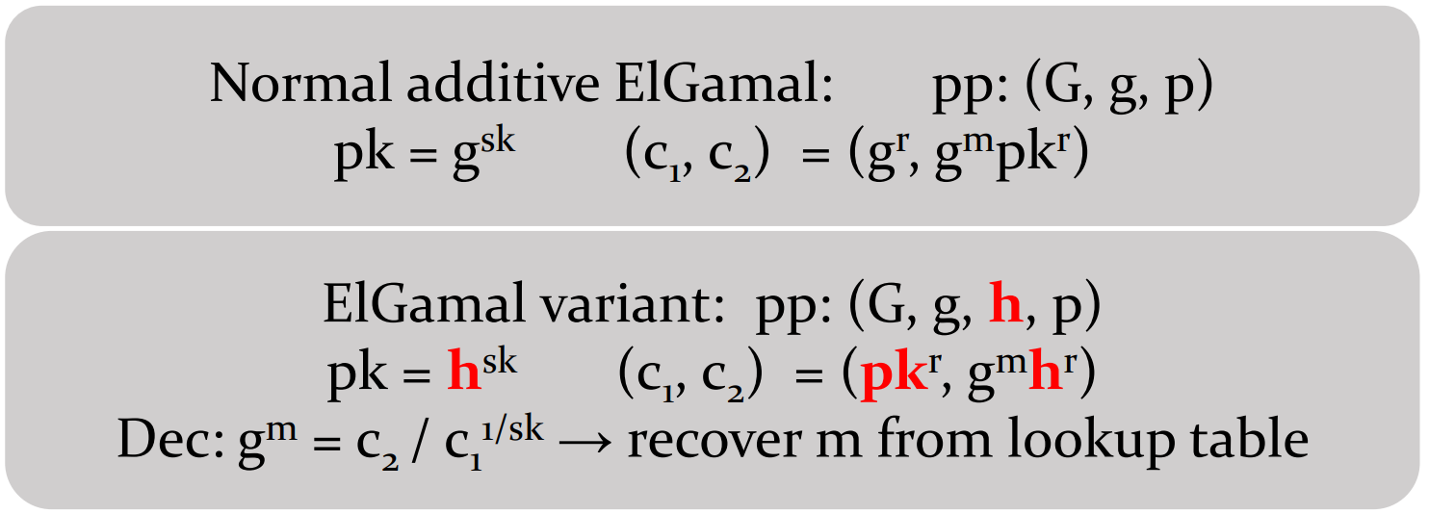
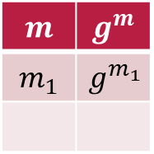
Preliminaries
$$m$$ | $$g^{m}$$
$$m_{1}$$ | $$g^{m_{1}}$$
ElGamal Encryption Variant

Slide 10

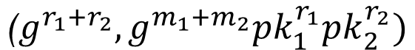
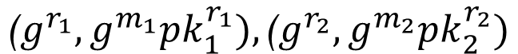
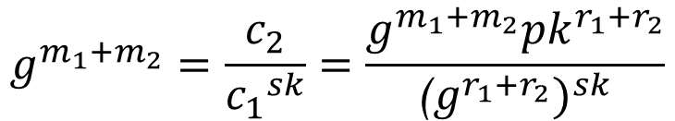
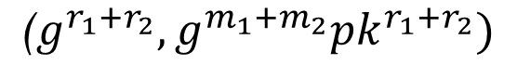

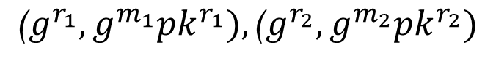
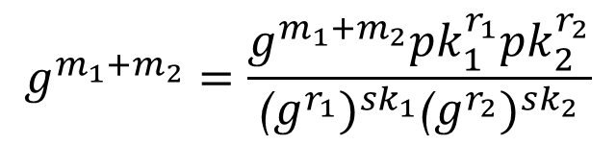
Preliminaries
相同公钥：
$${\text{(}g}^{r_{1}},g^{m_{1}}{pk}^{r_{1}}),{\text{(}g}^{r_{2}},g^{m_{2}}{pk}^{r_{2}})$$
$${\text{(}g}^{{r_{1}+r}_{2}},g^{{m_{1}+m}_{2}}{pk}^{r_{1}+r_{2}})$$
$$g^{m_{1}+m_{2}}=\frac{c_{2}}{{c_{1}}^{sk}}=\frac{g^{{m_{1}+m}_{2}}{pk}^{r_{1}+r_{2}}}{{{\text{(}g}^{{r_{1}+r}_{2}})}^{sk}}$$
✓
不同公钥：
$${\text{(}g}^{r_{1}},g^{m_{1}}{pk}_{1}^{r_{1}}),{\text{(}g}^{r_{2}},g^{m_{2}}{pk}_{2}^{r_{2}})$$
$${\text{(}g}^{{r_{1}+r}_{2}},g^{{m_{1}+m}_{2}}{pk}_{1}^{r_{1}}{pk}_{2}^{r_{2}})$$
$$g^{m_{1}+m_{2}}=\frac{g^{{m_{1}+m}_{2}}{pk}_{1}^{r_{1}}{pk}_{2}^{r_{2}}}{{{\text{(}g}^{r_{1}})}^{sk_{1}}{{\text{(}g}^{r_{2}})}^{sk_{2}}}$$
✘
$聚合后g^{r_{1}},g^{r_{2}}未知，$无法解密

Slide 11
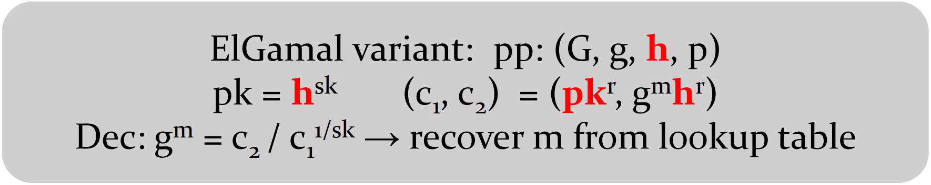
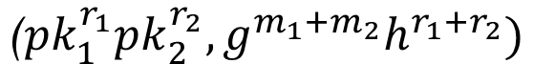
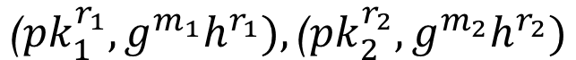
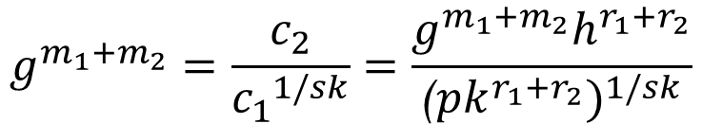
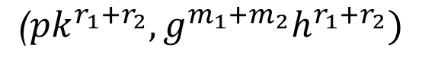
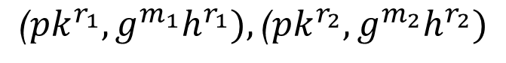
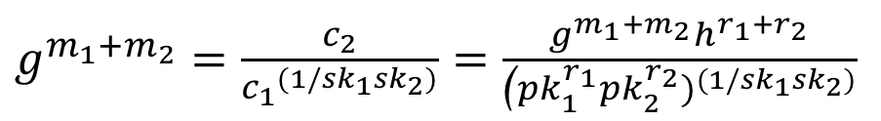
Preliminaries
相同公钥：
$${\text{(}pk}^{r_{1}},g^{m_{1}}h^{r_{1}}),{\text{(}pk}^{r_{2}},g^{m_{2}}h^{r_{2}})$$
$${\text{(}pk}^{{r_{1}+r}_{2}},g^{{m_{1}+m}_{2}}h^{r_{1}+r_{2}})$$
$$g^{m_{1}+m_{2}}=\frac{c_{2}}{{c_{1}}^{1/sk}}=\frac{g^{{m_{1}+m}_{2}}h^{r_{1}+r_{2}}}{{{\text{(}pk}^{{r_{1}+r}_{2}})}^{1/sk}}$$
✓
不同公钥：
$${\text{(}pk}_{1}^{r_{1}},g^{m_{1}}h^{r_{1}}),{\text{(}pk}_{2}^{r_{2}},g^{m_{2}}h^{r_{2}})$$
$${\text{(}pk}_{1}^{r_{1}}{pk}_{2}^{r_{2}},g^{{m_{1}+m}_{2}}h^{r_{1}+r_{2}})$$
$g^{m_{1}+m_{2}}=\frac{c_{2}}{{c_{1}}^{(1/sk_{1}sk_{2})}}=$ $\frac{g^{{m_{1}+m}_{2}}h^{r_{1}+r_{2}}}{{{\text{(}pk}_{1}^{r_{1}}{pk}_{2}^{r_{2}})}^{(1/sk_{1}sk_{2})}}$
✓
若取$r_{1}+r_{2}=0, m_{1}+m_{2}=0$，对$m_{1}$、 $m_{2}$分别加密，密文同态后$c_{2}=1$

Slide 12
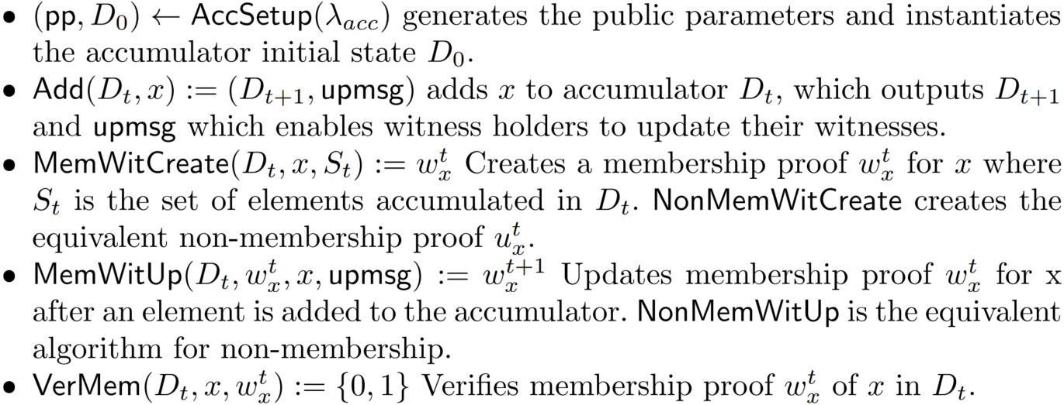
Preliminaries
Cryptographic Accumulators

Slide 13
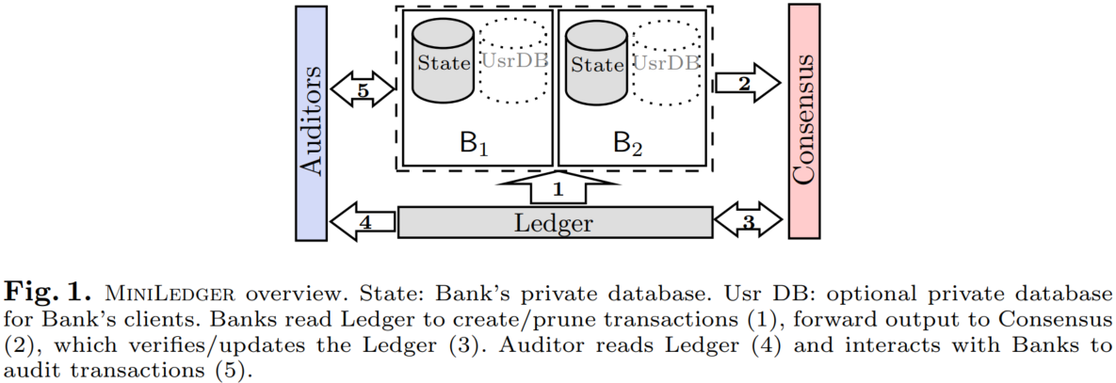
MiniLedger Model
可信第三方（初始化）
银行
共识节点
审计者
银行读取链上用于生成/裁剪交易的数据
银行创建新交易/裁剪旧交易，节点共识
共识数据上链
对链上数据审计
对链下裁剪数据审计

Slide 14
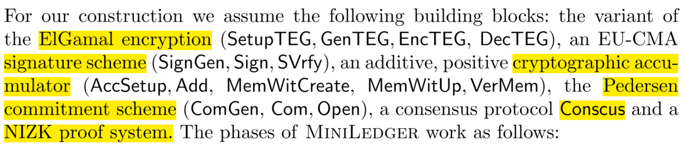
MiniLedger Construction

Slide 15
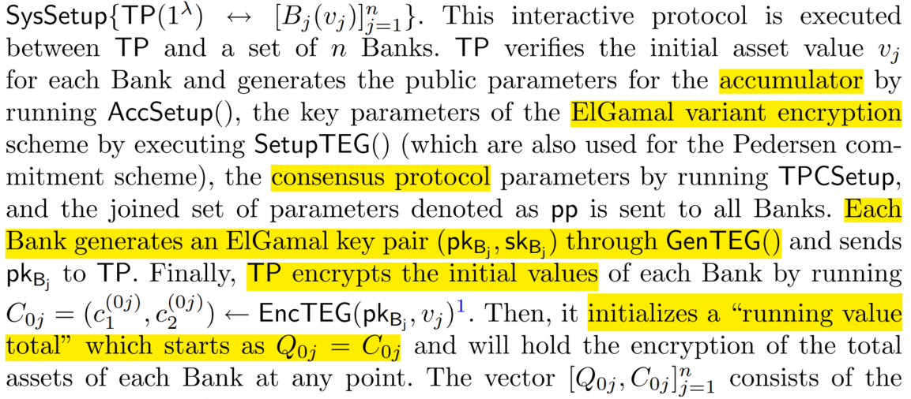

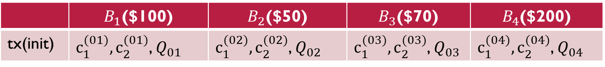
Setup
 | $B_{1}$($100) | $B_{2}$($50) | $B_{3}$($70) | $B_{4}$($200)
tx(init) | $c_{1}^{(01)},c_{2}^{(01)}$, $Q_{01}$ | $c_{1}^{(02)},c_{2}^{(02)}$, $Q_{02}$ | $c_{1}^{(03)},c_{2}^{(03)}$, $Q_{03}$ | $c_{1}^{(04)},c_{2}^{(04)}$, $Q_{04}$

Slide 16
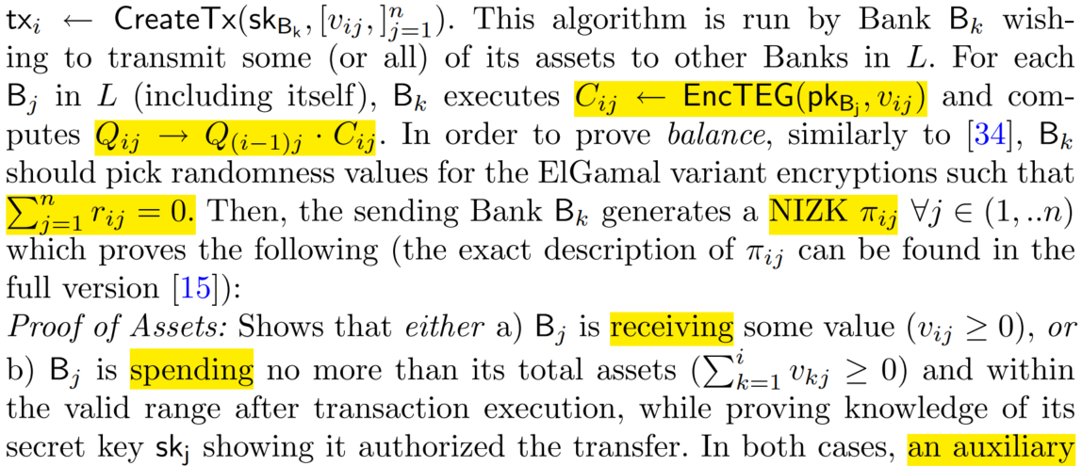
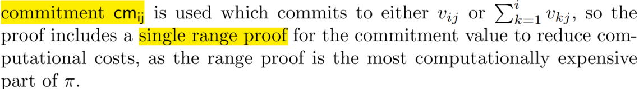
Transaction Creation

Slide 17
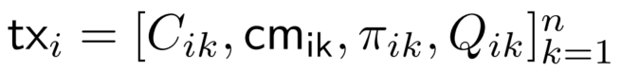
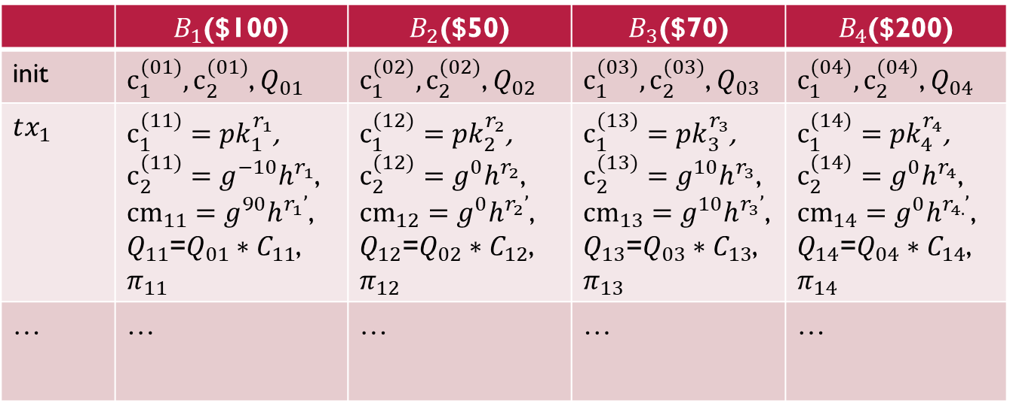
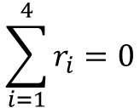
Transaction Creation
 | $B_{1}$($100) | $B_{2}$($50) | $B_{3}$($70) | $B_{4}$($200)
init | $c_{1}^{(01)},c_{2}^{(01)}$, $Q_{01}$ | $c_{1}^{(02)},c_{2}^{(02)}$, $Q_{02}$ | $c_{1}^{(03)},c_{2}^{(03)}$, $Q_{03}$ | $c_{1}^{(04)},c_{2}^{(04)}$, $Q_{04}$
$$tx_{1}$$ | $c_{1}^{(11)}=pk_{1}^{r_{1}}$, $c_{2}^{(11)}=g^{−10}h^{r_{1}}$, ${cm}_{11}=g^{90}h^{r_{1}’}$, $Q_{11}$=$Q_{01}∗C_{11}$, $$π_{11}$$ | $c_{1}^{(12)}=pk_{2}^{r_{2}}$, $c_{2}^{(12)}=g^{0}h^{r_{2}}$, ${cm}_{12}=g^{0}h^{r_{2}’}$, $Q_{12}$=$Q_{02}∗C_{12}$, $$π_{12}$$ | $c_{1}^{(13)}=pk_{3}^{r_{3}}$, $c_{2}^{(13)}=g^{10}h^{r_{3}}$, ${cm}_{13}=g^{10}h^{r_{3}’}$, $Q_{13}$=$Q_{03}∗C_{13}$, $$π_{13}$$ | $c_{1}^{(14)}=pk_{4}^{r_{4}}$, $c_{2}^{(14)}=g^{0}h^{r_{4}}$, ${cm}_{14}=g^{0}h^{r_{4.}’}$, $Q_{14}$=$Q_{04}∗C_{14}$, $$π_{14}$$
$$\text{…}$$ | … | … | … | …
$$\sum_{i=1}^{4}{r_{i}}=0$$

Slide 18
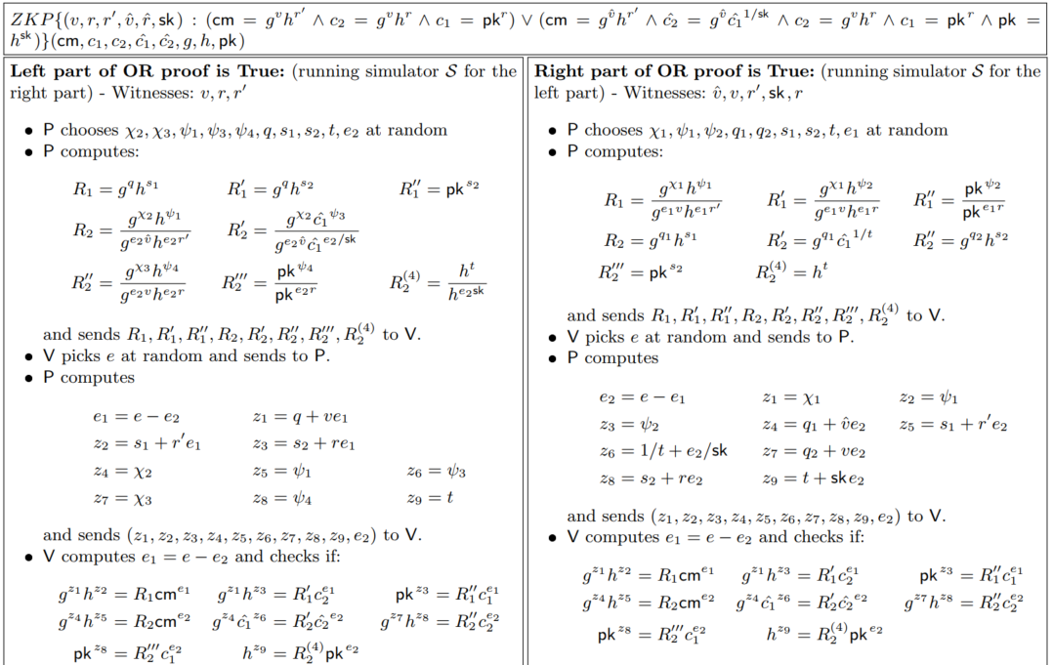

Slide 19
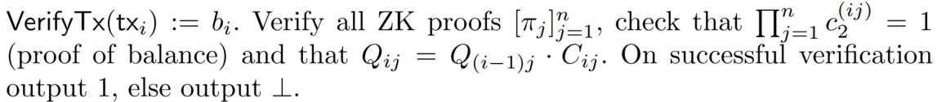
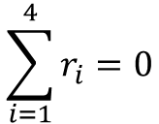
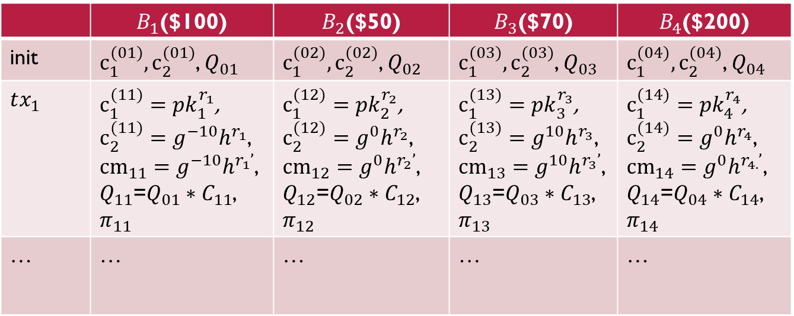
Transaction Mining
 | $B_{1}$($100) | $B_{2}$($50) | $B_{3}$($70) | $B_{4}$($200)
init | $c_{1}^{(01)},c_{2}^{(01)}$, $Q_{01}$ | $c_{1}^{(02)},c_{2}^{(02)}$, $Q_{02}$ | $c_{1}^{(03)},c_{2}^{(03)}$, $Q_{03}$ | $c_{1}^{(04)},c_{2}^{(04)}$, $Q_{04}$
$$tx_{1}$$ | $c_{1}^{(11)}=pk_{1}^{r_{1}}$, $c_{2}^{(11)}=g^{−10}h^{r_{1}}$, ${cm}_{11}=g^{−10}h^{r_{1}’}$, $Q_{11}$=$Q_{01}∗C_{11}$, $$π_{11}$$ | $c_{1}^{(12)}=pk_{2}^{r_{2}}$, $c_{2}^{(12)}=g^{0}h^{r_{2}}$, ${cm}_{12}=g^{0}h^{r_{2}’}$, $Q_{12}$=$Q_{02}∗C_{12}$, $$π_{12}$$ | $c_{1}^{(13)}=pk_{3}^{r_{3}}$, $c_{2}^{(13)}=g^{10}h^{r_{3}}$, ${cm}_{13}=g^{10}h^{r_{3}’}$, $Q_{13}$=$Q_{03}∗C_{13}$, $$π_{13}$$ | $c_{1}^{(14)}=pk_{4}^{r_{4}}$, $c_{2}^{(14)}=g^{0}h^{r_{4}}$, ${cm}_{14}=g^{0}h^{r_{4.}’}$, $Q_{14}$=$Q_{04}∗C_{14}$, $$π_{14}$$
$$\text{…}$$ | … | … | … | …
$$\sum_{i=1}^{4}{r_{i}}=0$$

Slide 20
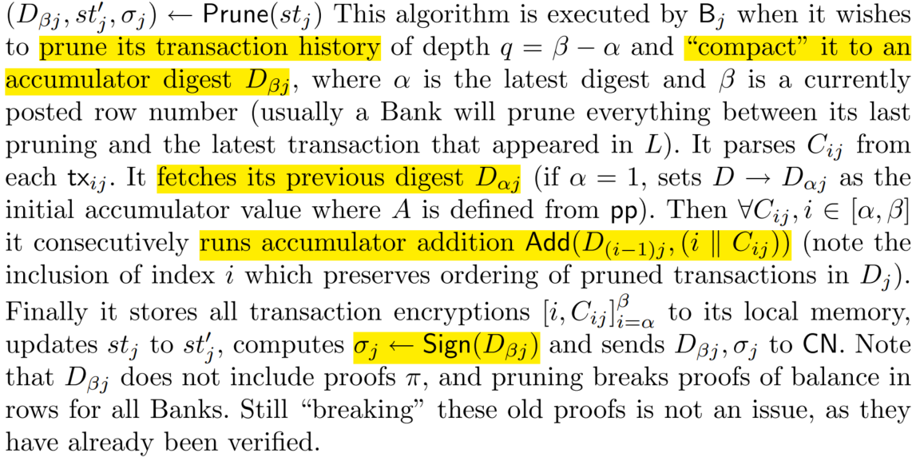
Transaction Pruning

Slide 21

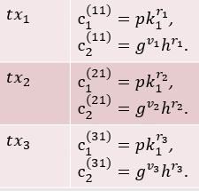

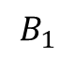
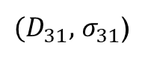
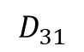
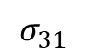
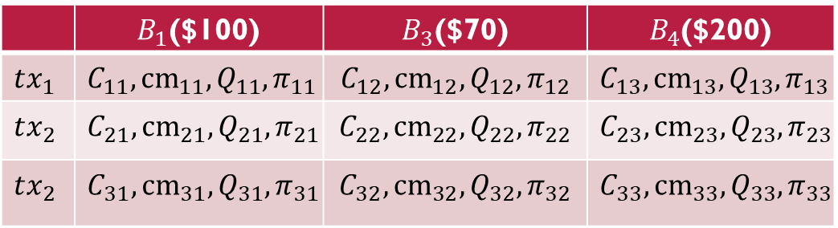
Transaction Pruning
 | $B_{1}$($100) | $B_{3}$($70) | $B_{4}$($200)
$$tx_{1}$$ | $$C_{11},{cm}_{11},{Q_{11},π}_{11}$$ | $$C_{12},{cm}_{12},{Q_{12},π}_{12}$$ | $$C_{13},{cm}_{13},{Q_{13},π}_{13}$$
$$tx_{2}$$ | $$C_{21},{cm}_{21},{Q_{21},π}_{21}$$ | $$C_{22},{cm}_{22},{Q_{22},π}_{22}$$ | $$C_{23},{cm}_{23},{Q_{23},π}_{23}$$
$$tx_{2}$$ | $$C_{31},{cm}_{31},{Q_{31},π}_{31}$$ | $$C_{32},{cm}_{32},{Q_{32},π}_{32}$$ | $$C_{33},{cm}_{33},{Q_{33},π}_{33}$$
$$B_{1}$$
$$σ_{31}$$
$$D_{31}$$
$(D_{31},$ $σ_{31}$)

Slide 22
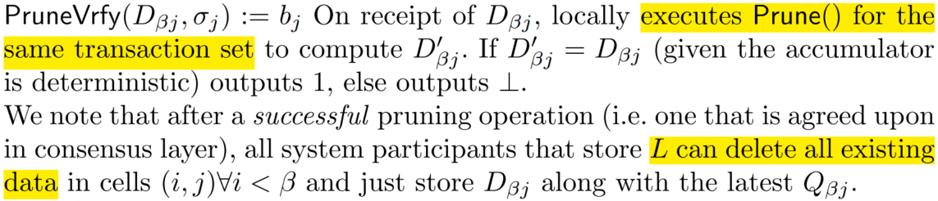
Transaction Pruning

Slide 23




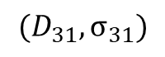
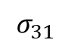
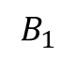
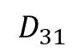
Transaction Pruning
 | $B_{1}$($100) | $B_{3}$($70) | $B_{4}$($200)
$$tx_{1}$$ | $$C_{11},{cm}_{11},{Q_{11},π}_{11}$$ | $$C_{12},{cm}_{12},{Q_{12},π}_{12}$$ | $$C_{13},{cm}_{13},{Q_{13},π}_{13}$$
$$tx_{2}$$ | $$C_{21},{cm}_{21},{Q_{21},π}_{21}$$ | $$C_{22},{cm}_{22},{Q_{22},π}_{22}$$ | $$C_{23},{cm}_{23},{Q_{23},π}_{23}$$
$$tx_{3}$$ | $$C_{31},{cm}_{31},{Q_{31},π}_{31}$$ | $$C_{32},{cm}_{32},{Q_{32},π}_{32}$$ | $$C_{33},{cm}_{33},{Q_{33},π}_{33}$$
$${(D}_{31},σ_{31})$$
$$B_{1}$$
$$σ_{31}$$
…
$$D_{31}$$

Slide 24
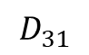
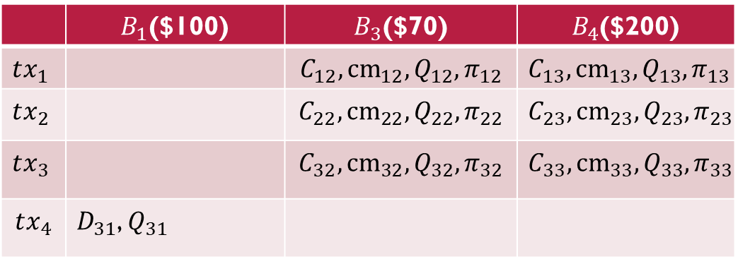

Transaction Pruning
 | $B_{1}$($100) | $B_{3}$($70) | $B_{4}$($200)
$$tx_{1}$$ |  | $$C_{12},{cm}_{12},{Q_{12},π}_{12}$$ | $$C_{13},{cm}_{13},{Q_{13},π}_{13}$$
$$tx_{2}$$ |  | $$C_{22},{cm}_{22},{Q_{22},π}_{22}$$ | $$C_{23},{cm}_{23},{Q_{23},π}_{23}$$
$$tx_{3}$$ |  | $$C_{32},{cm}_{32},{Q_{32},π}_{32}$$ | $$C_{33},{cm}_{33},{Q_{33},π}_{33}$$
$$tx_{4}$$ | $D_{31}$, $Q_{31}$
$$D_{31}$$
$$B_{1}$$
✓
✓
$$σ_{31}$$
…
保留$上一笔交易的Q$
✓
$$D_{31}$$

Slide 25
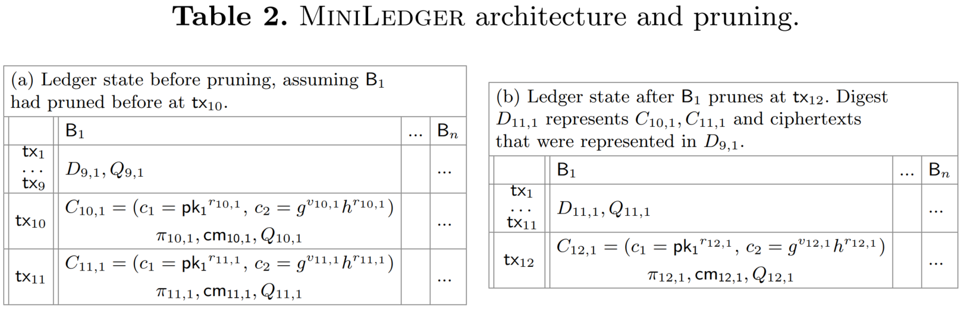
Transaction Pruning
多次裁剪

Slide 26







Auditing
单银行单笔交易审计
$$v_{ij},π^{Aud}$$
$$C_{ij}$$
$${DecTEG(C}_{ij})$$
$$B_{1}$$

Slide 27



NIZK
$$r∈z_{q}^{∗}$$
$$R=c_{1}^{r}$$
$$e=H(c_{1},c_{2},v_{ij},pk_{j},g,h,R)$$
$$z=r−sk_{ij}^{−1}e$$
$$π^{Aud}=(R,z)$$
$$π^{Aud}$$
$$e=H(c_{1},c_{2},v_{ij},pk_{j},g,h,R)$$
Check $R=c_{1}^{z}{\left(\frac{c_{2}}{g^{v_{ij}}}\right)}^{e}$?

Slide 28





Auditing
单银行多笔交易审计
$\sum{v_{ij}},$ $π^{Aud}$
$\sum{C_{ij}}$
$DecTEG(\sum{C_{ij}}$)
$$B_{1}$$

Slide 29





Auditing
部分在链上，部分在银行
交易裁剪审计
$$C_{ij},w_{ij}$$
$$D_{ij}$$
$$B_{1}$$

Slide 30




Auditing
银行余额交易审计
$v_{0}+\sum{v_{ij}},$ $π^{Aud}$
$$Q_{ij}$$
$$B_{1}$$

Slide 31
NIZK

Slide 32
NIZK
 | $B_{1}$($100) | $B_{2}$($50) | $B_{3}$($70) | $B_{4}$($200)
init | $c_{1}^{(01)},c_{2}^{(01)}$, $Q_{01}$ | $c_{1}^{(02)},c_{2}^{(02)}$, $Q_{02}$ | $c_{1}^{(03)},c_{2}^{(03)}$, $Q_{03}$ | $c_{1}^{(04)},c_{2}^{(04)}$, $Q_{04}$
$$tx_{1}$$ | $c_{1}^{(11)}=pk_{1}^{r_{1}}$, $c_{2}^{(11)}=g^{−10}h^{r_{1}}$, ${cm}_{11}=g^{90}h^{r_{1}’}$, $Q_{11}$=$Q_{01}∗C_{11}$, $$π_{11}$$ | $c_{1}^{(12)}=pk_{2}^{r_{2}}$, $c_{2}^{(12)}=g^{0}h^{r_{2}}$, ${cm}_{12}=g^{0}h^{r_{2}’}$, $Q_{12}$=$Q_{02}∗C_{12}$, $$π_{12}$$ | $c_{1}^{(13)}=pk_{3}^{r_{3}}$, $c_{2}^{(13)}=g^{10}h^{r_{3}}$, ${cm}_{13}=g^{10}h^{r_{3}’}$, $Q_{13}$=$Q_{03}∗C_{13}$, $$π_{13}$$ | $c_{1}^{(14)}=pk_{4}^{r_{4}}$, $c_{2}^{(14)}=g^{0}h^{r_{4}}$, ${cm}_{14}=g^{0}h^{r_{4.}’}$, $Q_{14}$=$Q_{04}∗C_{14}$, $$π_{14}$$
$$\text{…}$$ | … | … | … | …
$$\sum_{i=1}^{4}{r_{i}}=0$$

Slide 33

$$H(…)$$

Slide 34



$$e=H(R_{1},R_{1}^{′},R_{1}^{′′},R_{2},…,cm,c_{1},…)$$

Slide 35



$$e=H(R_{1},R_{1}^{′},R_{1}^{′′},R_{2},…,cm,c_{1},…)$$

Slide 36


Evaluation - transaction

Slide 37

Comparison
zkLedger: Narula, N., Vasquez, W., Virza, M.: zkledger: privacy-preserving auditing for distributed ledgers. USENIX (2018)

Slide 38
Conclusion
We present MiniLedger, the first private and auditable payment system with storage independent to the number of transactions. MiniLedger utilizes existing cryptographic tools and innovates on the meticulous design of optimized ZK proofs to tackle important scalability issues in auditable, private payments. We achieve huge storage savings compared to previous works that store information for each transaction ever happened. Using our pruning techniques, the overall MiniLedger size can be impressively compacted to 70KB per Bank, no matter how many transactions have ever occurred. MiniLedger can currently serve a small consortium of Banks (e.g. the world’s Central Banks) with an arbitrary number of clients
关注：Elgama 同态加密、Sigma OR设计，账本结构设计

